Slide 1

ABC–SMC for Household Epidemic Models: Replicating Influenza Transmission Inference
Date: 12/09/2025
Trang Nguyen

Slide 2
Context AND motivation
Motivation:
  Stochastic models can describe complex processes.
  But several models are equally plausible => Model selection
  Problem with model selection in epidemiology:
    Only a subset of variables can be measured
    Intractable number of likelihood functions
    Observations can be noisy and incomplete
ABC
  To perform model selection
  Setting : can simulate data from model but cannot compute the likelihood
Notes:
Motivation and Context
In modern biomedical research, stochastic computer models are essential for describing complex processes such as epidemic spread, signal transduction, and gene regulation.
For many systems, we do not have a single agreed-upon model: several mechanistic hypotheses are often plausible, and it is not obvious which one is best supported by the data.
This makes model choice a central statistical problem: we need principled methods for deciding which mechanistic model gives the most convincing explanation of the observations.
In systems biology and epidemiology, this is particularly challenging because
only a limited subset of variables can be measured,
observations are noisy and incomplete, and
the corresponding likelihood functions are often analytically intractable.

Slide 3
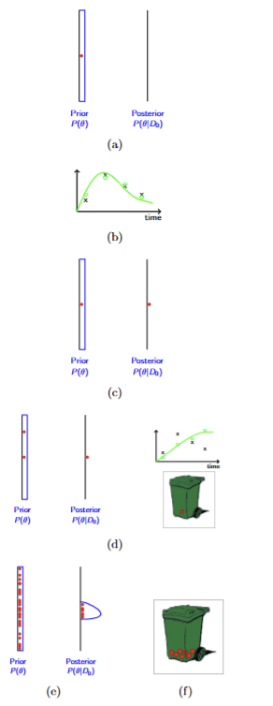
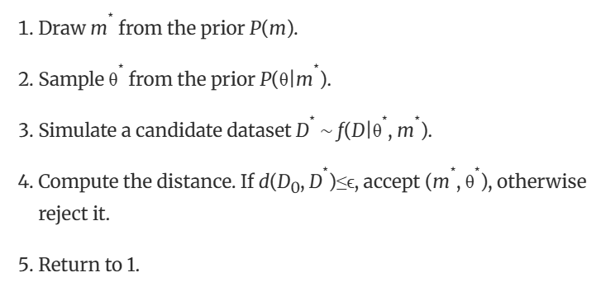
Context AND motivation
ABC
Toni et al. 2009, Bioinformatics
Notes:
Why ABC–SMC for model selection?
Mechanistic models in biology
Mathematical models encode our assumptions about complex systems (e.g. signalling pathways, host–parasite dynamics, epidemic spread).
We typically simulate these models and compare their predictions with data to test and refine them.
The core difficulty: intractable likelihoods
For realistic models, the likelihood ( f(D_0 \mid \theta, m) ) is often not available in closed form or is computationally prohibitive to evaluate.
Classical model selection tools (AIC, BIC, Bayes factors, etc.) all rely on having a tractable likelihood.
Data are usually sparse and noisy, and parameters are unknown and high-dimensional, which makes direct likelihood-based inference even harder.

Slide 4
ABC-sMC idea and distance

Slide 5
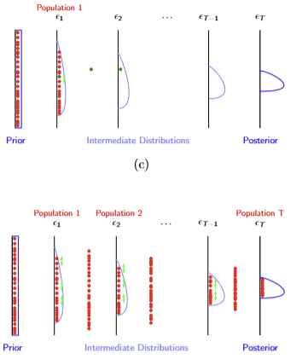
ABC - SMC
Toni et al. 2009, Bioinformatics
Notes:
At population 1, I sample the model $m$and parameters $θ$from their priors, simulate household tables for the two epidemics, and accept only if the Frobenius-norm distance from the observed tables is below $ε_{1}$“
or later populations, I resample and perturb particles, gradually lowering the tolerance schedule $ε_{t}$to concentrate on particles that produce simulations close to the observed influenza data.

Slide 6
goal

Slide 7
goal
Data: household final-size influenza A/B data from historical epidemics.
Goal: infer transmission parameters and compare models for influenza outbreaks
  i) infer community vs within-household infection probabilities
  ii) perform model comparison between simpler and more complex models.
Method: ABC–SMC
Replicate results of figures 3.a → d in the paper.
Notes:
I’m interested in ABC–SMC because epidemic models are naturally defined as stochastic simulators, but their likelihoods are often analytically intractable. For realistic household transmission models, computing $P\left(D∣θ\right)$exactly is extremely hard, whereas simulating outbreaks is straightforward.
“ABC–SMC lets me work directly with the simulator: I propose parameters, simulate epidemic outcomes, and keep particles whose simulated household tables are close to the observed influenza data.”
“The specific application here is to replicate the influenza household analyses in the supplementary tables: to (i) infer community vs within-household infection probabilities and (ii) perform model comparison between simpler and more complex models.”
Then clearly state your objectives:
“My code should (1) simulate outbreaks under different models, (2) run ABC–SMC with a model kernel and parameter kernel, (3) estimate posterior distributions of parameters, and (4) approximate posterior model probabilities, reproducing Figures 3a–3d of the paper.”

Slide 8
Models of the disease spread

Slide 9
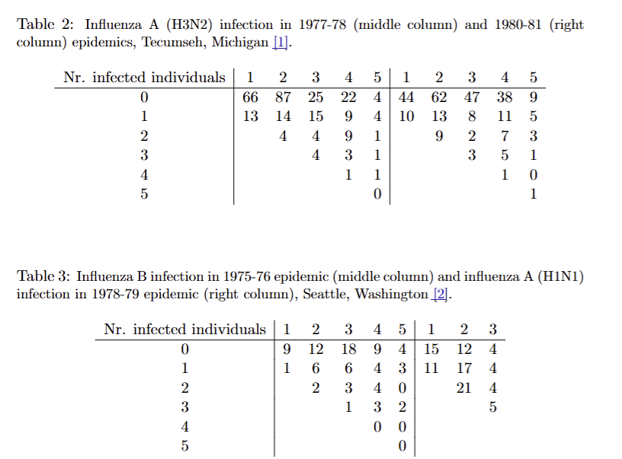
Household Data & Competing Transmission Models
Goal: infer transmission parameters and compare models for influenza outbreaks
Toni et al. 2009, Bioinformatics
Notes:
Supplementary Table 2 or 3
rows = # infected (0–5)
columns = household size (1–5),
entries = counts of households.
For Supplementary Table 2 (A 77–78 & 80–81):
Model 1 (2 parameters): shared (𝑞𝑐, 𝑞ℎ)across both epidemics.
Model 2 (4 parameters): (𝑞𝑐1,𝑞ℎ1) for 77–78, (𝑞𝑐2,𝑞ℎ2) for 80–81.
For Supplementary Table 3 (B 75–76 & A 78–79):
Model 1 (2 parameters): shared (𝑞𝑐,𝑞ℎ).
Model 2 (3 parameters): (𝑞𝑐1,𝑞𝑐2,𝑞ℎ)– shared within-household 𝑞ℎ, different community 𝑞𝑐​’s.
Table 2 (Influenza A)
Model 1: same community and household transmission for both A seasons.
Model 2: each A season gets its own community and household transmission parameters.
→ Tests whether A 1977–78 vs 1980–81 behaved similarly or not.
Table 3 (Influenza B)
Model 1: same community and household transmission for both B outbreaks.
Model 2: different community risk for the two B outbreaks, but same household spread.
→ Tests whether only the “background exposure” changed between B 1975–76 and 1978–79, or the household dynamics too.

Slide 10
Household Data & Competing Transmission Models
Goal: infer transmission parameters and compare models for influenza outbreaks
Toni et al. 2009, Bioinformatics
rows = # infected (0–5)
columns = household size (1–5),
entries = counts of households.
Table 2 (A 77–78 & 80–81):
Model 1 (2 parameters): shared (𝑞𝑐, 𝑞ℎ)across both epidemics. =>: same community and household transmission for both seasons.
Model 2 (4 parameters): (𝑞𝑐1,𝑞ℎ1) for 77–78, (𝑞𝑐2,𝑞ℎ2) for 80–81. => : each season gets its own community and household transmission parameters.
Notes:
(q_c): probability that a susceptible person escapes infection from the community
So (1 - q_c) = probability they get infected from outside (school, work, etc.).
(q_h): probability that a susceptible person escapes infection from within the household
So (1 - q_h) = probability they get infected by an infectious household member.

Slide 11
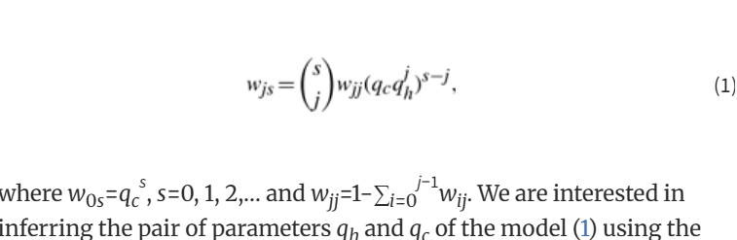
Household Data & Competing Transmission Models
Goal: infer transmission parameters and compare models for influenza outbreaks
Toni et al. 2009, Bioinformatics
Notes:
Household infection model parameters
Two key probabilities
Final size probabilities in a household
Consider a household with (s) susceptible individuals.
Let (w_{js}) = probability that exactly (j) out of these (s) people become infected by the end of the outbreak.
(w_{0s} = q_c^{,s}): everyone escapes community infection → nobody ever gets infected.
For (j > 0), (w_{js}) combines:
how many people get infected from the community vs. within the home,
and all the possible ways those (j) infections can be arranged among the (s) people
(this is where the binomial coefficient (\binom{s}{j}) and the powers of (q_c) and (q_h) come in).

Slide 12
Structure of the code project

Slide 13
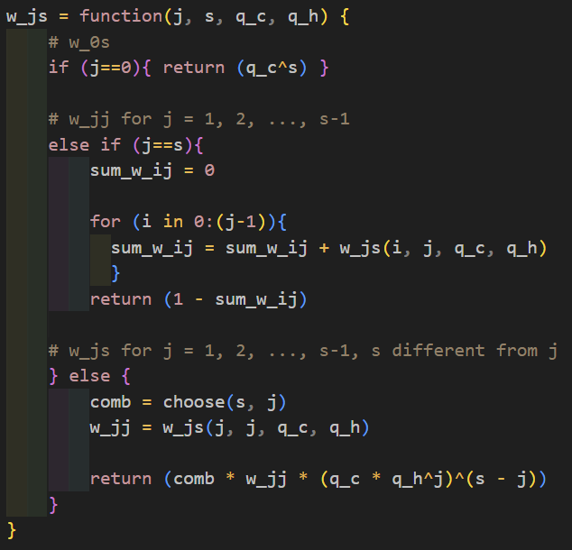
CODING LOGICS (1/2)
  Epidemic parameters
  w_js(j, s, q_c, q_h) – recursively computes Pr⁡(j infected ∣ s susceptibles).
  simulate_outbreak(q_c, q_h, D_obs) – simulates one outbreak table matching the column counts of D obs.
  simulate_data(theta, m, D0, n_params_by_model) – applies simulate_outbreak to both epidemics under the chosen model.
Toni et al. 2009, Bioinformatics
Notes:
I store all parameter vectors in an 𝑁×max_par N×max_par matrix, padding with NAs, so the code can handle both 2-, 3-, and 4-parameter models with the same SMC function.
The model kernel 𝐾𝑀 is discrete: with probability 0.7 I keep the same model as the ancestor; with probability 0.3 I flip to the other model.
The parameter kernel is a uniform 𝑈(−𝜎,𝜎)U(−σ,σ) around the ancestor, where 𝜎σ is half the range of previous particles for that model.
The importance weights use the usual ABC–SMC form: prior over (m, θ) divided by a mixture of kernels over previous particles; here the prior is uniform, so the numerator is constant and only the kernel mixture in the denominator matter

Slide 14

CODING LOGICS (2/2)
  ABC–SMC:
  prior_model(M) – draws model index uniformly from {1,…,M}.
  prior_theta_parameters(m, n_params_by_model) – draws parameters i.i.d. Uniform(0,1) with the correct dimension for model m.
  perturb_theta(theta_star, theta_prev_mat_model) – uniform kernel around previous particles for that model, truncated to [0,1].
  kernel_theta_density(theta_new, theta_prev, theta_prev_mat_model) – evaluates the density of that kernel (for importance weights).
  abc_smc_influenza(D0, epsilon_schedule, n_params_by_model, …) – main driver; returns models, thetas, weights.
Toni et al. 2009, Bioinformatics

Slide 15
RESulTS

Slide 16
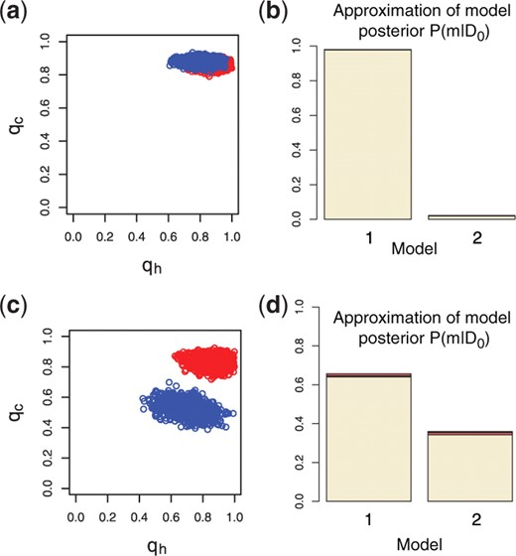

Expected results from the paper
Toni et al. 2009, Bioinformatics

Slide 17
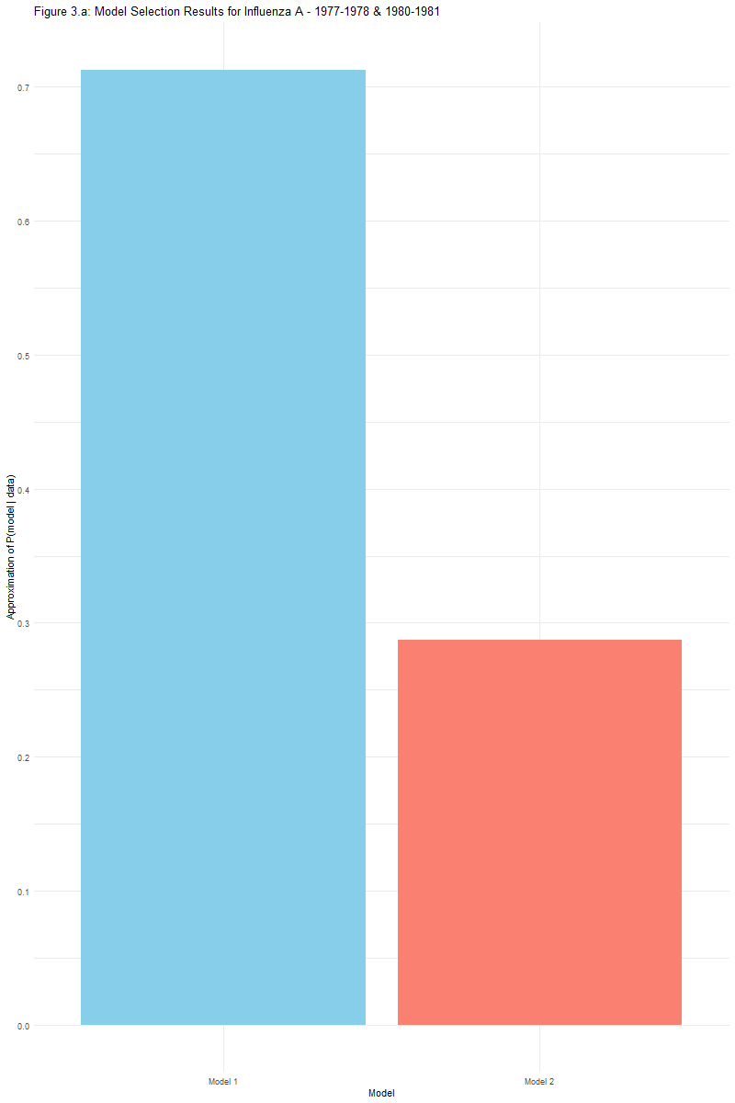
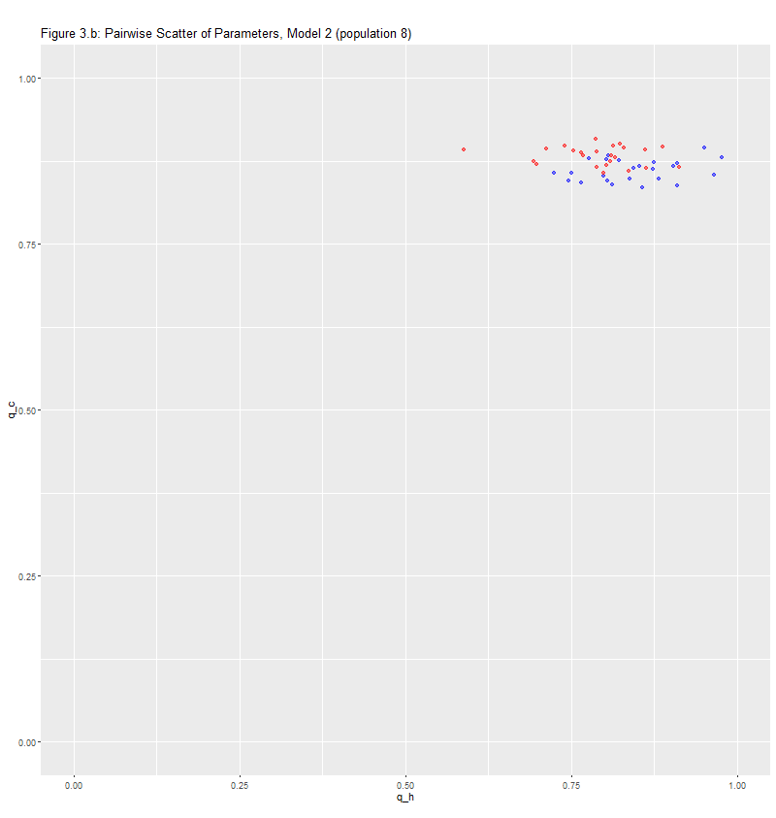
Supplementary table 2

Slide 18
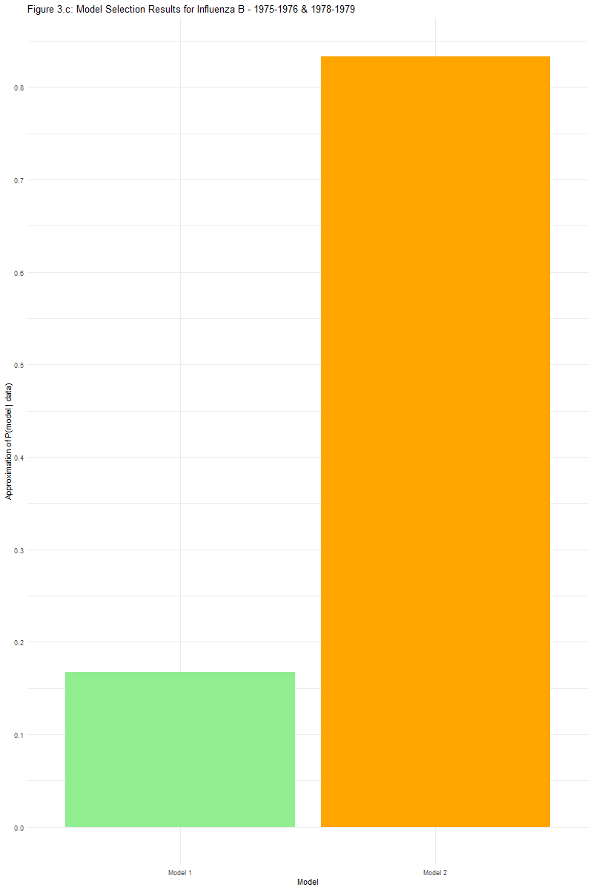
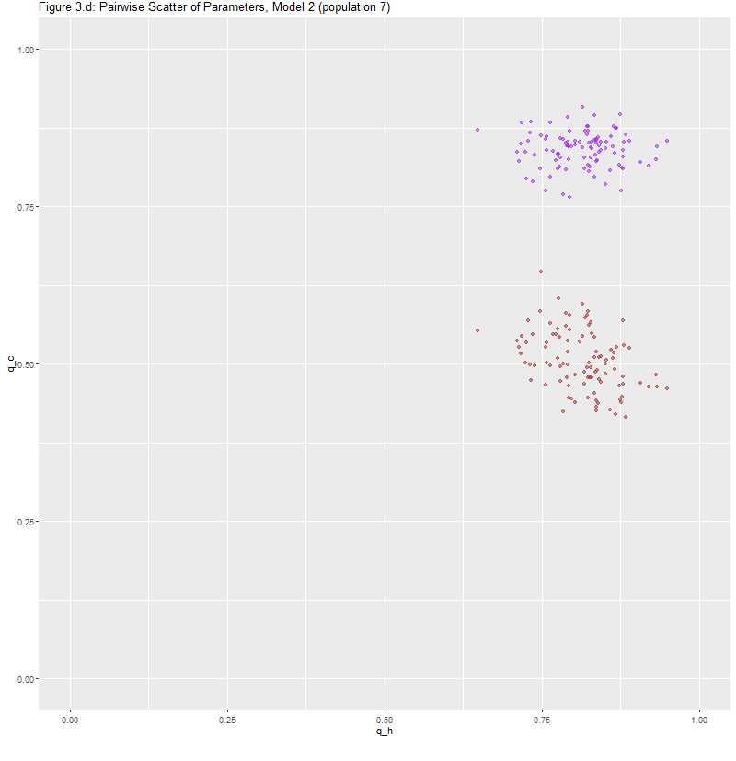
Supplementary table 2

Slide 19
Limitations and future direction

Slide 20
Limitation and future direction
Numerical issues:
  needed clipping in w_js and simulate_outbreak to prevent tiny negative probabilities from recursion and floating-point errors.
Algorithmic:
  sensitivity to the choice of tolerance schedule and N;
Future work:
more systematic tuning of epsilon and N;
more formal unit tests + refactoring to make abc_smc_influenza fully generic for other epidemic models.

Slide 21
THANK YOU!

